Slide 1

Heart Disease Prediction
by Group 9

Slide 2
Background Study
Heart illness is a catch-all phrase for a variety of aliments that have an impact on heart.
Congenital heart defects, arrhythmia, coronary artery disease, and other ailments are included.
In the United States, heart disease is the top cause of death for both men and women.
Smoking, diabetes, high cholesterol, high blood pressure, and a sedentary lifestyle are all risk factors for heart disease.
Depending on the kind and severity of the condition, treatment options for heart disease may include lifestyle modifications, drugs, surgery, and lifestyle modifications.

Slide 3
Business Objectives
Visual analysis will be performed using Tableau to achieve the aim.
SAS E Miner will be used for implementation of machine learning to achieve the aim.
Different models will be evaluated with error metrics in SAS and final model will be analyzed.

Slide 4
Data Source
https://www.kaggle.com/datasets/kamilpytlak/personal-key-indicators-of-heart-disease
Originally, the dataset come from the CDC and is a major part of the Behavioral Risk Factor Surveillance System (BRFSS), which conducts annual telephone surveys to gather data on the health status of U.S. residents.
The data set is recorded from telephonic survey conducted by CDC. The data set contain 18 features where the target variable is the heart disease. Out of 18 variables, 9 variables are Boolean, 5 variables are categorical and four variables are numeric in nature. The class of the data set are heavily imbalanced where there are very less samples of heart disease patients.

Slide 5
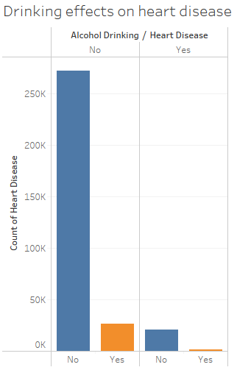
Findings Using Tableau
The graph shows there are more number of samples who do not drink alcohol and they do not have heart disease. Out of the samples who drink alcohol, it is found there are more samples who are normal than the samples who have heart disease. This indicates alcohol drinking do not have any relation with heart disease.

Slide 6
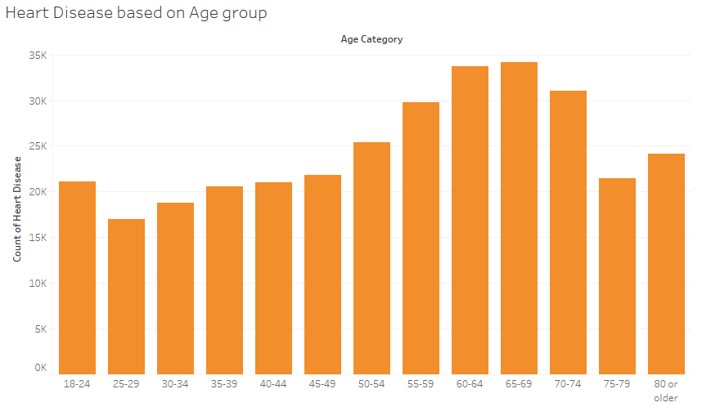
Heart disease can be related to age group so this visualization is used to look into the heart disease patients. Based on age group, it is seen that the patients who are ranging from 60 to 69 years of age are having more heart disease. This indicates older patients are more risky of having heart disease.

Slide 7
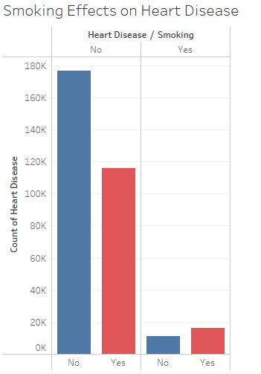
Patients who do not have heart disease and do not smoke are more than the patients who smoke. Also in case of patients having heart disease that comparatively more patients who smoke than the non-smoking patients. This shows that smoking can be related to heart disease.

Slide 8
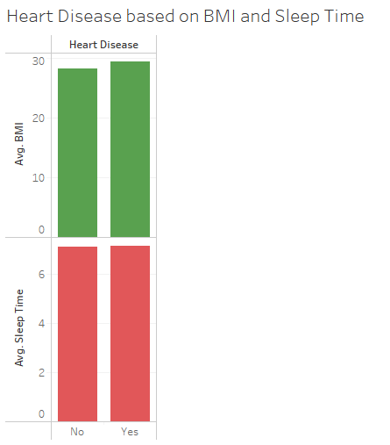
BMI and average sleep time can have relation with the heart disease. The plot shows the average BMI of patients having heart disease are higher than the normal patients. Also the average sleep time is comparatively higher than the sleep time of normal patients.

Slide 9
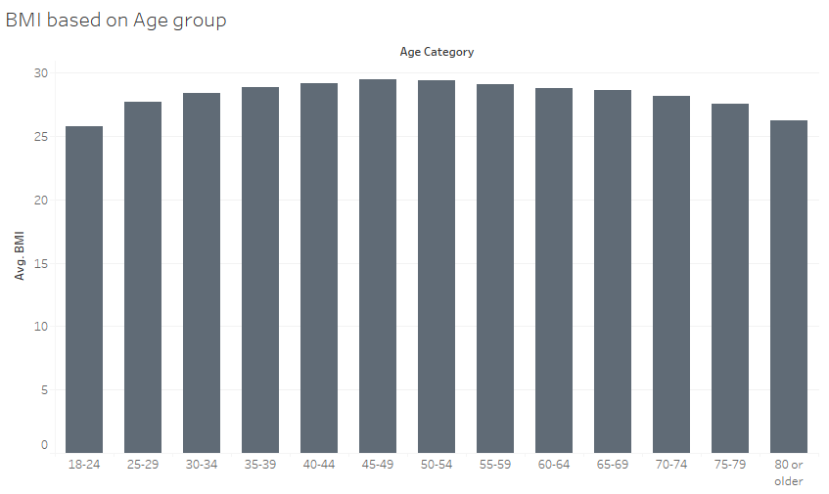
Since age is found to have relation with the heart disease, BMI is analyzed see that average BMI is present more in patients ranging from 45 to 65 years of age. This indicates that both BMI and age can have good correlation with heart disease and they can be used to decide whether a patient is going to have heart disease or not.

Slide 10
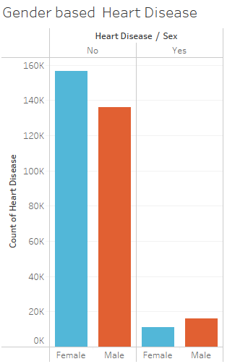
In normal patients, it is seen that there are more female patients then male who do not have heart disease. But in heart disease patient it is seen then male patients are comparatively higher than female patients. So this data can only be helpful to predict heart disease of male patients than female.

Slide 11
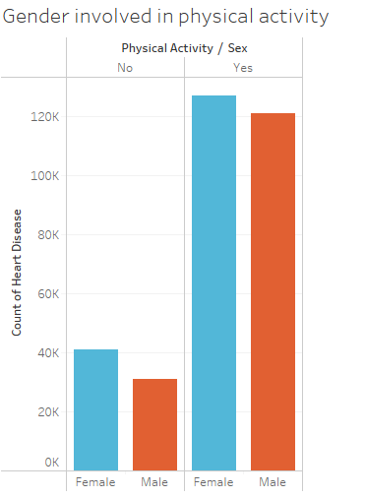
Physical activities can also improve the health in heart disease. The patients who are not involved in physical activities are comparatively female more than male. Also patients who are having physical activities are also female comparatively to male. This indicates that female patients are more involved in physical activities than male patients.

Slide 12
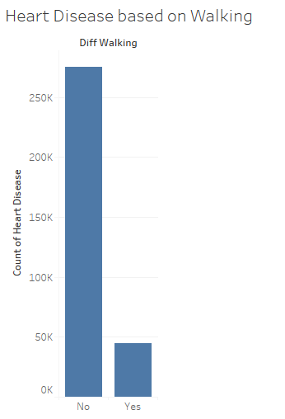
Difficulty in working can also contribute to heart disease where there are more number of patients who do not have difficulties in walking in this data. So this data can be suitable to predict only heart disease for those patients who do not have any difficulty in walking.

Slide 13
Data Exploration and Preprocessing
For exploration of missing values, Excel is used and for scaling or techniques, SAS is used.
Missing Data
The data do not contain null values in any column.
Data Inconsistency
The data contain feature which have relation to the target. Also there could be more columns like cholesterol, BP, etc., which can predict heart disease more efficiently. Also the data is imbalanced which can give biased estimates.
Data Reduction
The data contain 18 features which are adequate. Also the data is suitable to present US population. So no reduction is necessary.

Slide 14
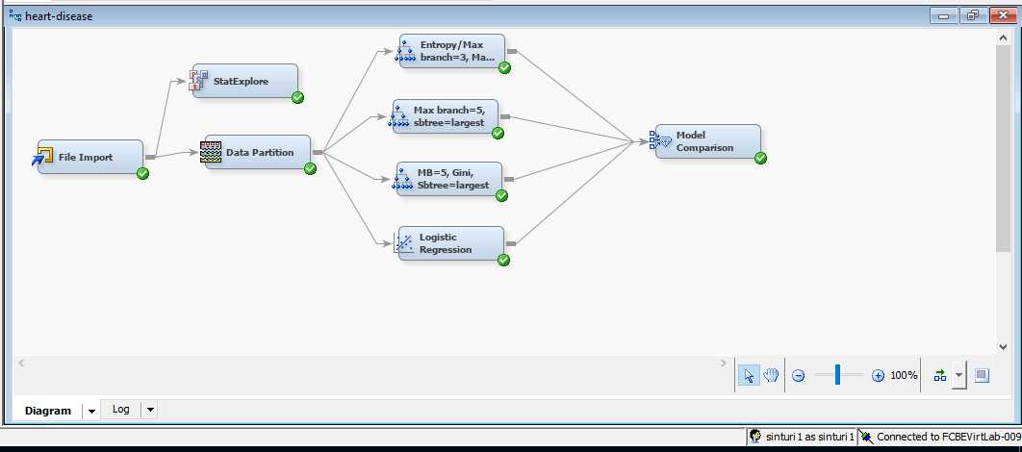
Predictive Modelling
For predictive modelling purposes, SAS EM is used where exploration of the data is carried out and data is partitioned into training and validation. Also different decision trees are implemented in training data and predicted in test data.

Slide 15
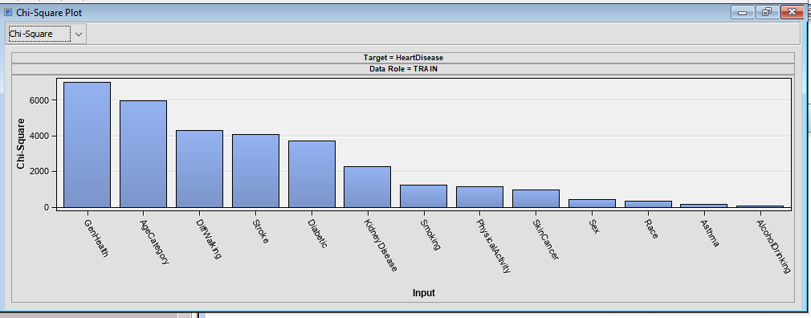
Variable Exploration
From Chi square Analysis, the variables like Genhealth, Agecategory, Diffwalking, stroke, diabetic are some of the variables that decide the rate of heart disease in patients.

Slide 16
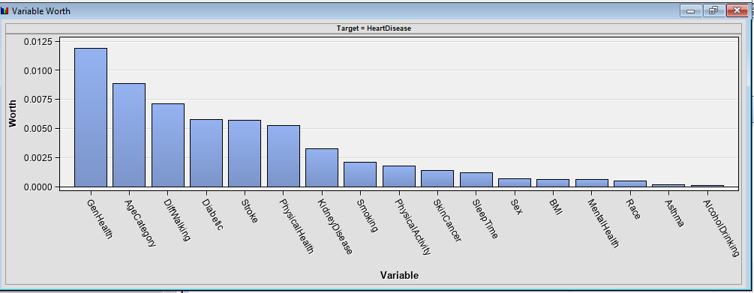
GenHealth, Age Category and DiffWalking are also the worthiest variables found from the data. In future prediction of heart disease, these variables can be used.

Slide 17
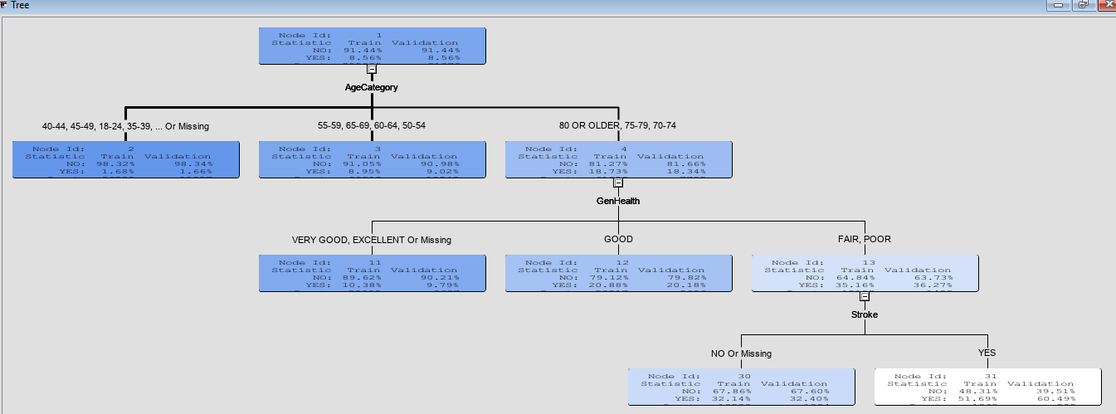
Model Training Results Decision Tree 1
From the tree, we can see that Agecategory is used for the first split .So Agecategory is the most important variable as per the given tree.

Slide 18
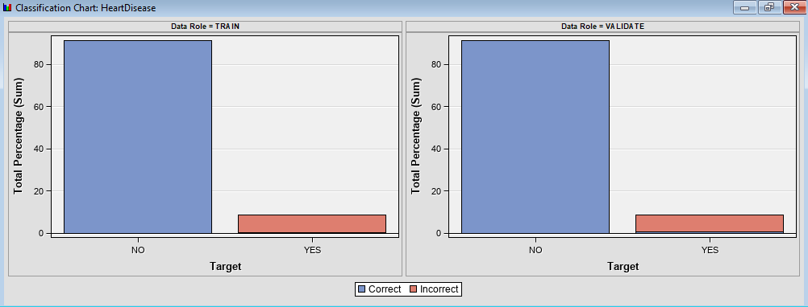
The data looks imbalanced where there are only few patients who are having heart diseases in the data. The mis classification rate is highly observed in patients having heart disease. This is because the decision tree cannot be well trained on samples due to minimum presence of observations in train data.

Slide 19
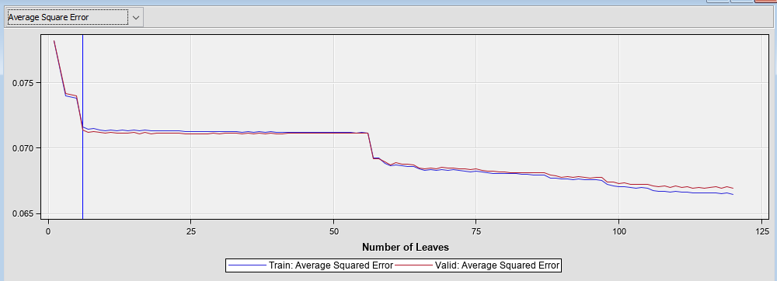
The average square error is observed in different leaves where the tree gives the minimum error in 6 leaves but after that the error also decreased after 50 leaves. So this tree with 6 leaves gives the optimum performance and the valid average squared error is lower than the train average squared error given by this tree.

Slide 20
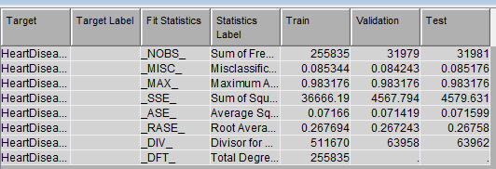
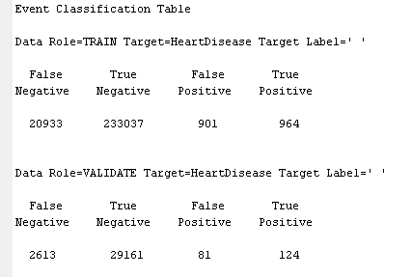
The test error is slightly lower than the train error that shows that the model is giving good performance with lower error in test data.
There are few heart disease samples and almost half of the samples are misclassified in train data and more than half of the samples are miss classified in validation data.

Slide 21
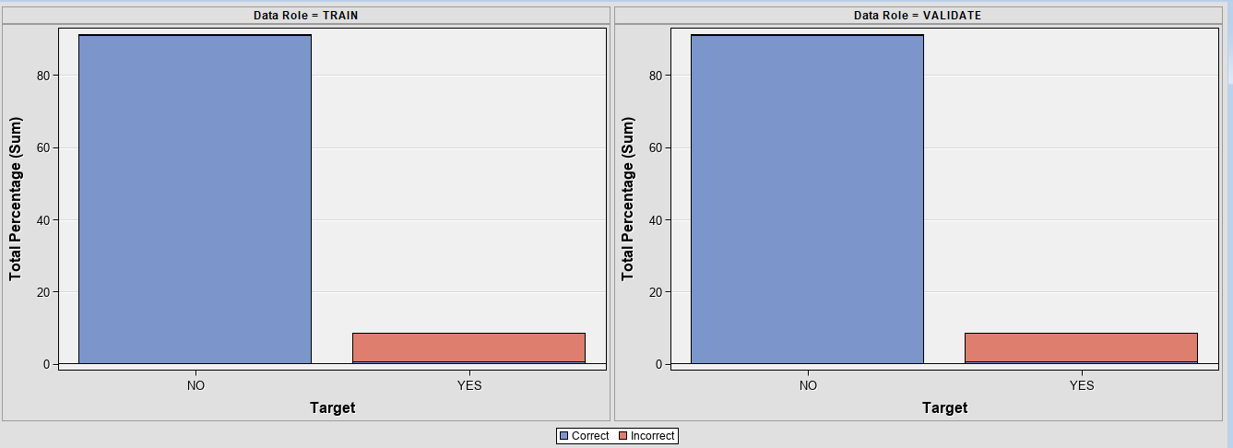
Decision Tree 2
The classification chart show similar performance to the previous decision tree where the tree wrongly classified the samples with heart disease. The tree is suffering in learning the patterns in imbalanced samples.

Slide 22
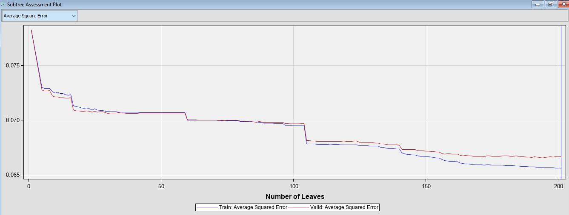
In 201 leaves, the tree gives the optimal performance but it seems that the validation average squared error is increasing compared to the train error. This tree is giving a good indication of overfitting at high number of leaves.

Slide 23
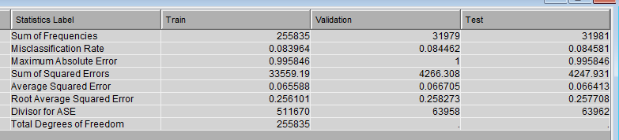
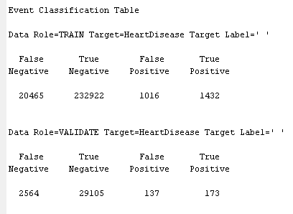
There error in train and test data is slightly lower to the previous tree which shows that increasing the branches improve the performance in prediction of heart disease.
The classification table also shows a good true positive rate indicating a good improvement in prediction of patients having heart disease.

Slide 24
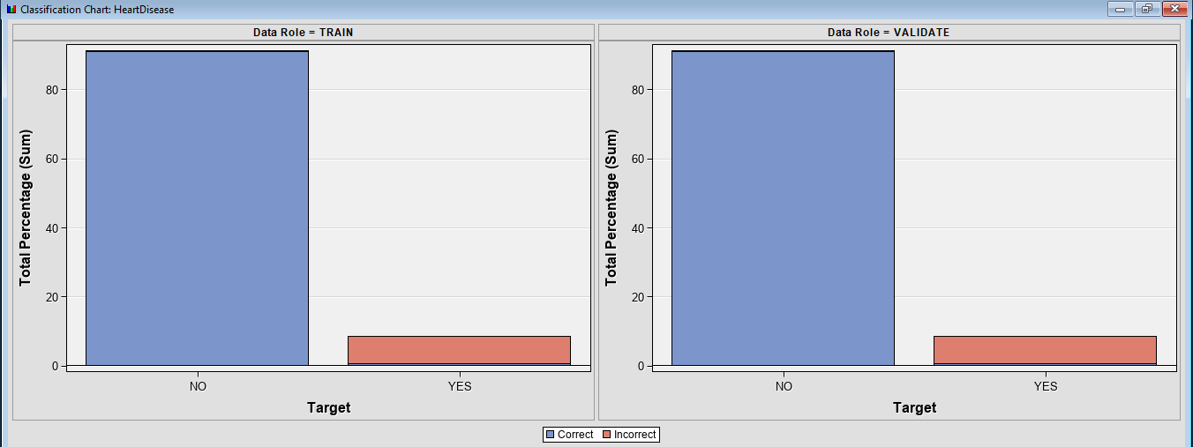
Decision Tree 3
Using Gini as the nominal target criteria the model does not show any improvement as seen from the plot. However, the exact classification rate can be seen from the classification table to see the exact number of observations that are misclassified.

Slide 25
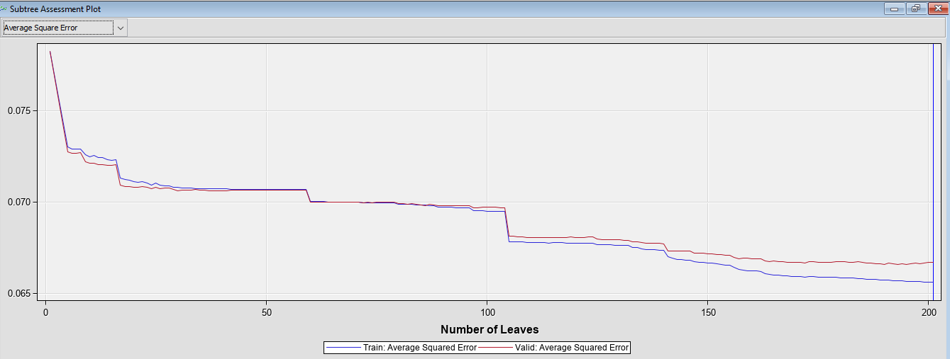
The same number of leaves is considered to be optimal were the average square error in valid data is likely higher than train data. After 100 leaves the model seems to show a good indication of overfitting where the validation error is increasing compared to the train error.

Slide 26
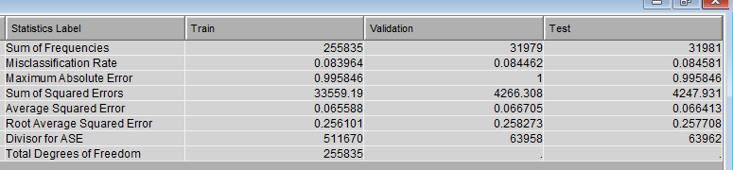
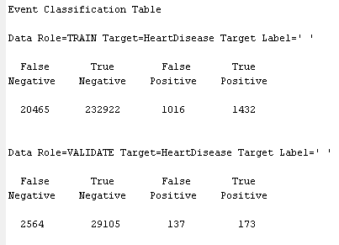
The fit statistics also show similar performance using Gini impurity measures where the test error is a bit higher than the train error.
The classification table shows no improvement had been observed using Gini impurities measures compared to the previous decision tree with same parameters. This indicates using different nominal target criterion does not improve the performance.

Slide 27
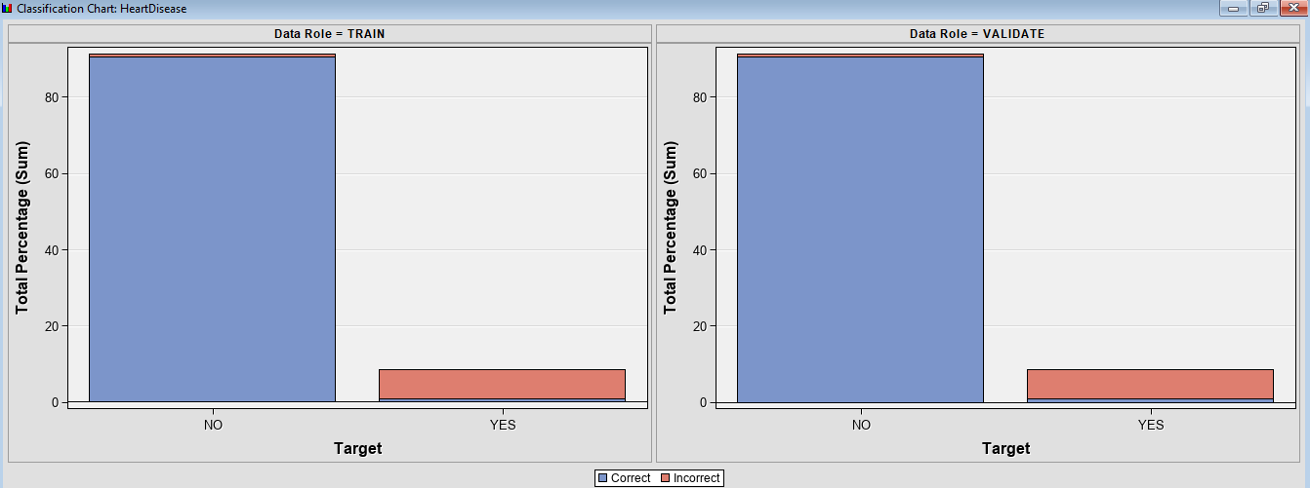
Logistic Regression
Using logistic regression, the misclassification rate in patients having heart disease is slightly improved which can be seen from the plot. The red region in minimum observations had been reduced compared to the previous models.

Slide 28
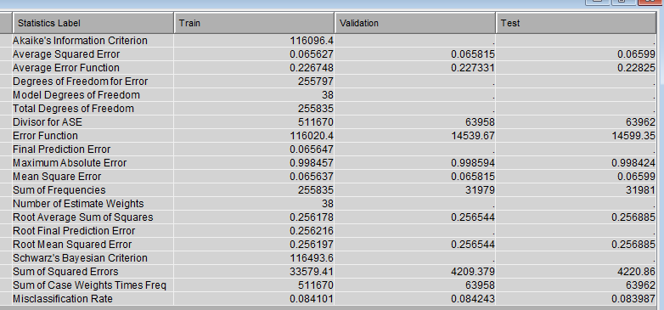
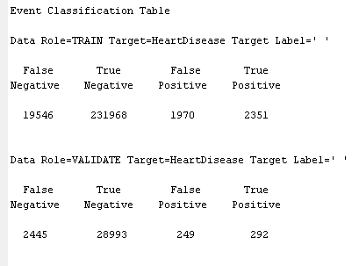
The mean squared error can be seen where the mean squared error in test data is slightly higher than the train data. After testing the model in real time observations, Logistic regression can give over fitting performance.
The classification table shows must higher true positive samples which indicates that the highest number of patients having heart disease is correctly classified by the Logistic regression compared to the previous decision trees.

Slide 29
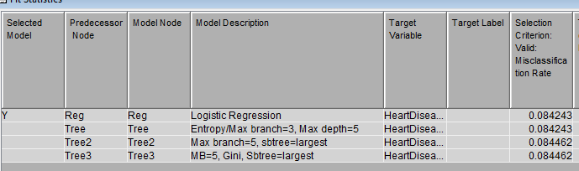
Model Evaluation Criteria & Final Model
The misclassified samples can be seen from the classification table of all the models where we can see that Logistic regression gave the highest true positive samples that indicates correctly classified samples of patients having heart disease.
We have focused on the prediction performance in those patients having heart disease as we wanted to inspect the performance of models in imbalanced data.

Slide 30
Interpretation of Findings
From the visualizations of variables and predictive performance, we noticed following:
The age category of the patients had been divided into too many groups which can bring bias to the prediction.
The data contain very few samples of patients having disease that affected the overall performance of models
The model mostly contain categorical variables from which ordinality issues can be observed
Decision trees with maximum branches helps to bring improvement in prediction of heart disease

Slide 31
Recommendations
The following approaches can be recommended for future work;
The data should be added with more samples of patients having heart disease making the data balance the data
Instead of Label encoding the categorical variable, one hot encoding can be used to prevent ordinary issues
Neural network techniques and other classification technique such as ensemble techniques, bagging techniques or boosting techniques can be applied to determine the predictive performance
Different other variables relevant to the heart disease such as cholesterol, blood pressure and other indicators can be studied for better analysis.

Slide 32
Summary & Lessons Learned
Age of a patient can decide occurrence of heart disease
BMI of a patient can also decide the presence of heart disease
Age and BMI also have good relation where BMI is found higher in older age patients
There are more female patients in the data who are involved in physical activities
Smoking habits have also good relation with the heart disease
Decision tree with increasing branches increases the chance of overfitting
It is difficult to bring good accuracy in imbalanced samples.

Slide 33
Future Work
There are more relevant features like cholesterol, blood pressure that can be added in future
The data of heart disease patients can be added in order to balance the sample
The features with more correlation with heart disease can be updated for better prediction
The parameters of the model can be tuned in case of improving the prediction.

Slide 34


